Slide 1
BASELINE FOR: Active voice, Comprehension (1C)

Slide 2
INSTRUCTIONS: You are going to see two pictures: one on your left and one on your right. Press the button that is on the side of the picture that matches the sounds you hear.

Slide 3
Block 1

Slide 4

bah bah
1a

Slide 5

bah bah (high pitch x2)
1b

Slide 6

bah bah
1c

Slide 7

bah bah (low pitch x2)
1d

Slide 8
Block 2

Slide 9

bah bah
2a

Slide 10

bah bah
2b

Slide 11

bah bah (2 x low pitch)
2c

Slide 12

bah bah (2 x high pitch)
2d

Slide 13
Block 3

Slide 14
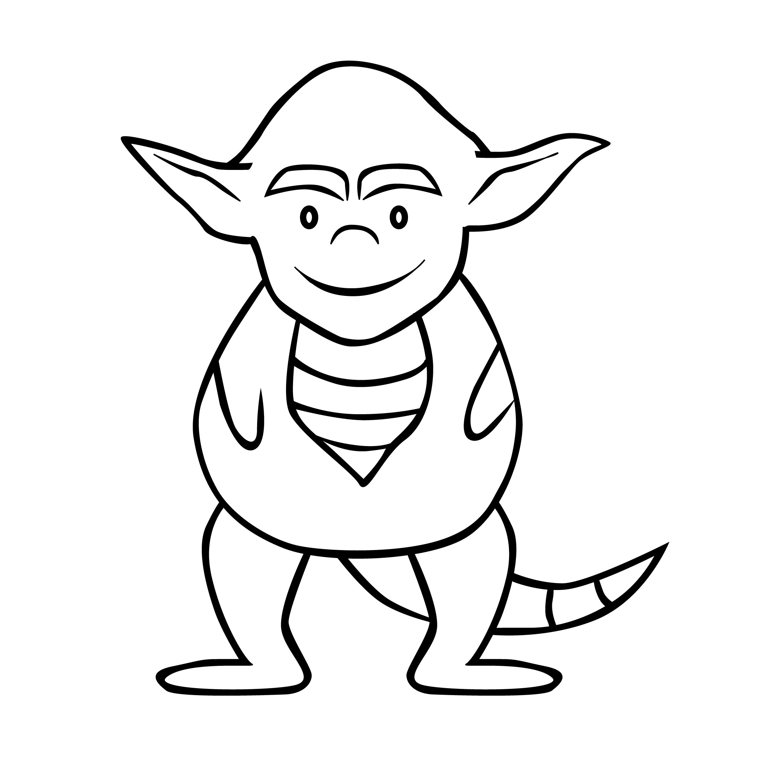
bah bah (2 x high pitch)
3a

Slide 15

3b
bah bah (2 x low pitch)

Slide 16

bah bah
3c

Slide 17

bah bah
3d

Slide 18
Block 4

Slide 19

4a
bah bah (2 x low pitch)

Slide 20

bah bah
4b

Slide 21

bah bah (2 x high pitch)
4c

Slide 22

bah bah
4d

Slide 23
BASELINE FOR: Active Voice, Production (1P)

Slide 24
INSTRUCTIONS: Silently say your bah so that it matches the picture you see.

Slide 25
Block 1

Slide 26
1a

Slide 27
1b

Slide 28
1c

Slide 29
1d

Slide 30
Block 2

Slide 31
2a

Slide 32
2b

Slide 33
2c

Slide 34
2d

Slide 35
Block 3

Slide 36
3a

Slide 37
3b

Slide 38
3c

Slide 39
3d

Slide 40
Block 4

Slide 41
4a

Slide 42
4b

Slide 43
4c

Slide 44
4d

